Slide 1
AI POWERED WILDLIFE TRACKING SYSTEM
BY MRIDULA ARUN KUMAR
DIVYA KEERTHANA S
KAVYA SRI K

Slide 2
Why WildGuard?
Problem statement
Endangered wildlife may come near roads, settlements, agricultural land and poaching risk zones, even within their reserves.
Manually tracking GPS and incident data at scale for each animal in a reserve is very challenging.
Rangers need a single view of animals, locations, risk events, alerts and predictions.
The system couples DBMS concepts with PostGIS spatial processing and an AI Prediction layer.

Slide 3
Objectives
To create a wildlife database tracking the risk assignment and handling by rangers.
Design and develop a management system which will help in tracking animals, their whereabouts and potential risk events.
Logging the data of risk events, ranger assignments and handling.
Training an ai prediction model which will help avoid and manage risk events encountered by endangered animals more efficiently.

Slide 4
Module flow
WildGuard System
Wildlife Data → PostgreSQL +PostGIS → SQL Queries → Monitoring Dashboard
Animals & Tracking
Animal
Species
GPS_Tracking
Device
Health_Record
Reserve & Spatial Data
Reserve
Habitat_Zone
Risk_Zone
Risk Management
Animal_Risk_Event
Alert
Alert_Assignment
Staff Management
Ranger
Risk Management
Animal_Risk_Event
Alert
Alert_Assignment

Slide 5
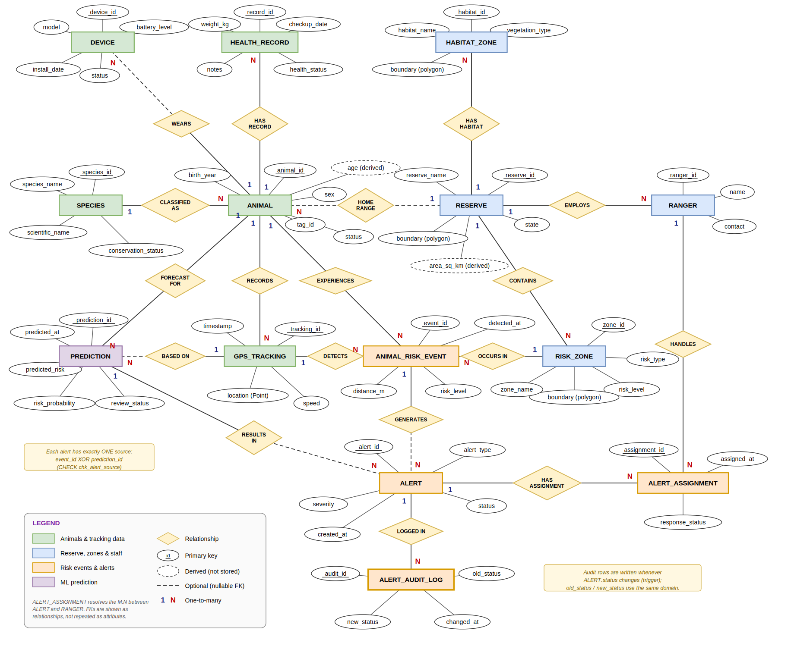

Slide 6
CORE RELATIONSHIPS
Species → Animal
CLASSIFIED AS
One species can have many animals.
Each animal belongs to one species.
species_id is the foreign key in Animal.
Reserve → Animal
HOME RANGE
A reserve can be the home range of many animals.
An animal may optionally have a home reserve.
home_reserve_id is nullable.
Animal → GPS_Tracking
RECORDS
One animal can have many GPS tracking records.
Every GPS record belongs to an animal.
Animal → Device
WEARS
An animal may have a tracking device.
Device assignment is optional.
Animal → Health_Record
HAS RECORD
An animal can have multiple health records.
Every health record belongs to an animal.

Slide 7
RISK & SPATIAL RELATIONSHIPS
Reserve → Risk_Zone
CONTAINS
A reserve can contain multiple risk zones.
Reserve → Habitat_Zone
HAS HABITAT
A reserve can contain multiple habitat zones.
Reserve → Ranger
EMPLOYS
A reserve can employ multiple rangers.
GPS_Tracking → Animal_Risk_Event
DETECTS
GPS tracking information is used to associate an observed location with a risk event.
Animal → Animal_Risk_Event
EXPERIENCES
An animal can experience multiple risk events.
Risk_Zone → Animal_Risk_Event
OCCURS IN
A risk event occurs within a particular risk zone.

Slide 8
ALERT MANAGEMENT-Alert & Ranger Response System
Animal_Risk_Event → Alert
GENERATES
A detected risk event can generate an alert.
Alert → Alert_Assignment
HAS ASSIGNMENT
An alert can be assigned to rangers through the Alert_Assignment entity.
Ranger → Alert_Assignment
HANDLES
A ranger can handle multiple alert assignments.

Slide 9
NORMALIZATION & INTEGRITY
1NF — First Normal Form
Attributes contain atomic values.
Each record represents one entity occurrence.
Separate records are maintained for GPS tracking, health records and risk events.
2NF — Second Normal Form
Non-key attributes depend on the complete primary key.
Entity-specific information is stored in separate tables.
Foreign keys establish relationships between tables.
3NF — Third Normal Form
No unnecessary transitive dependencies.
Species information remains in Species.
Reserve information remains in Reserve.
Ranger information remains in Ranger.
Risk-zone information remains in Risk_Zone.

Slide 10
SPATIAL DATABASE
The database is used to:
Find animals within a particular zone.
Determine whether a GPS location lies inside a boundary.
Calculate distances between animals and risk zones.
Identify risk events based on geographical location.
Spatial attributes
GPS_Tracking
location
Stored as a Point
Reserve
boundary
Stored as a Polygon
Risk_Zone
boundary
Stored as a Polygon
Habitat_Zone
boundary
Stored as a Polygon

Slide 11
SPATIAL Queries
SELECT a.animal_id, s.species_name
FROM Animal a
JOIN Species s
ON a.species_id = s.species_id;
SELECT risk_level, COUNT(*)
FROM Animal_Risk_Event
GROUP BY risk_level;
SELECT animal_id, tag_id
FROM Animal
WHERE species_id IN
(
SELECT species_id
FROM Species
WHERE conservation_status = 'Endangered'
);
SELECT g.tracking_id, rz.zone_name
FROM GPS_Tracking g
JOIN Risk_Zone rz
ON ST_Within(g.location, rz.boundary);

Slide 12
Main BUSINESS logic :
GPS fix → risk event → alert → ranger assignment
T1 (trg_gps_validate): rejects bad GPS fixes (dead animal, out-of-range coordinates, future timestamp, negative speed). It also computes speed from the previous fix if the collar didn’t report it.
T2 (trg_gps_risk_check): geofencing. Inside a risk zone gives an event at the zone’s level. Within 500 m gives an event one level lower. Duplicates within 1 hour are suppressed.
T3 / T4: risk events (medium and above) and predictions (high and critical) automatically create alerts.
T5 (trg_alert_assign): assigns each non-info alert to the least-busy ranger in the reserve (load balancing).
T6 / T7: ranger responses keep the alert status in sync, and every status change is written to Alert_Audit_Log.
T8: rejecting or overriding a prediction dismisses its alert and clears the ranger’s task (human-in-the-loop AI).
T9 to T11: collar battery rules (auto-inactive at 0%), a deceased health record marks the animal deceased, and that switches off its collars.
T12 / T13: tag normalisation, birth-year checks, and validation that zone geometry is valid and overlaps its reserve.

Slide 13
Pl/SQL components
Functions:
fn_animals_outside_reserve: boundary-crossing detection
fn_animals_near_point: human-animal conflict (“which animals are near this village?”)
fn_distance_travelled_km: distance covered using LAG()
fn_home_range_km2: home range via convex hull
fn_animal_track_geojson: movement path as a GeoJSON line for mapping
fn_animal_status: latest position, reserve check and nearest risk zone, using <-> KNN with LATERAL
Monitoring and anomaly detection
fn_silent_collars: no fix for N hours suggests collar failure
fn_stationary_animals: barely moving suggests possible injury or death
fn_low_battery_devices: collars needing attention
fn_animal_risk_score: weighted 0–100 score from recent events.
Predictive logic:
sp_generate_predictions: a rule-based “AI” that extrapolates the next position linearly from the last two fixes. It then checks that point against risk zones and the reserve boundary, assigns a risk level and probability, and stores the prediction.
Alert lifecycle: sp_acknowledge_alert, sp_resolve_alert, sp_reassign_alert, sp_dismiss_alert, sp_escalate_stale_alerts (auto-escalates unattended warning/critical alerts)
Registration: sp_register_animal, sp_assign_device, sp_record_health_checkup
Automation: sp_run_monitoring_cycle (can be scheduled with pg_cron) and sp_generate_daily_report
sp_safe_insert_gps: demonstrates exception handling
Views (dashboards):
v_open_alerts, v_animal_latest_position, v_reserve_risk_summary, v_ranger_workload, v_species_dashboard, v_device_health, v_animal_health_latest, v_high_risk_animals, v_prediction_review_queue, v_zone_hotspots

Slide 14
CONCLUSION
WildGaurd provides a structured database solution for wildlife conservation monitoring.
The system integrates:
Animal and species management
GPS-based movement tracking
Health records
Tracking devices
Reserve and habitat management
Risk-zone monitoring
Risk-event detection
Ranger alerts and assignments
Spatial database capabilities

Slide 15
Thank you

